Slide 1
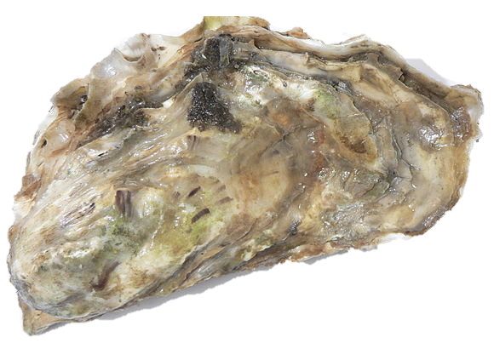

The genetic legacy of the deliberate introduction of Pacific oysters
Erik Sotka
Allan Strand
Ryan Carnegie, Jim Carlton, Lucia Couceiro, Jeff Crooks, Hikaru Endo, Hilary Heyford, Masakazu Hori, Mits Kamiya, Gen Kanaya, Judith Kochmann, Kun-Seop Lee, Lauren Lees, Hannah Miller, Massa Nakaoka, Eric Pante, Jennifer Ruesink, Evangelina Schwindt, Åsa Strand, Richard Taylor, Ryuta Terada, Martin Thiel, Takefumi Yorisue, Danielle Zacherl

Slide 2
Biological invasions are a major driver of ecosystem degradation. The number of invasive alien species is increasing rapidly with no evidence that either the rate of species introduction or the emergence of new invasive species is slowing down. Pyšek et al 2020 Biological Review
One critical piece of the puzzle in the understanding of biological invasions is an understanding of the his- tory of the invasion process, including the geographical pathways followed by the founders of the invading populations. Indeed, the genetic variability of invading populations, in terms of both molecular and quantita- tive traits, depends on the history of their populations of origin and the historical and demographical features of their introduction. Estoup and Guillemaud 2010 ME.

Slide 3
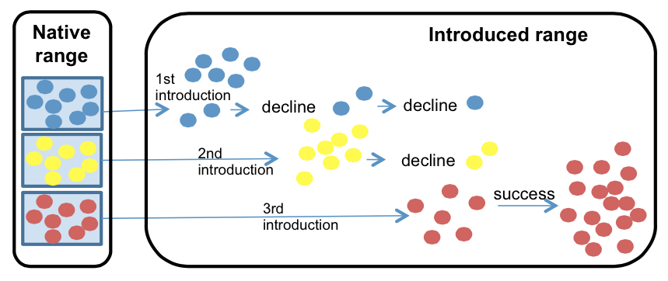
The utility of identifying vectors and the sources of invasive species
Prevent further invasions
Understand how it succeed
Understand its future threat (adaptive capacity)
Rius et al. 2014 Biol. Inv.

Slide 4
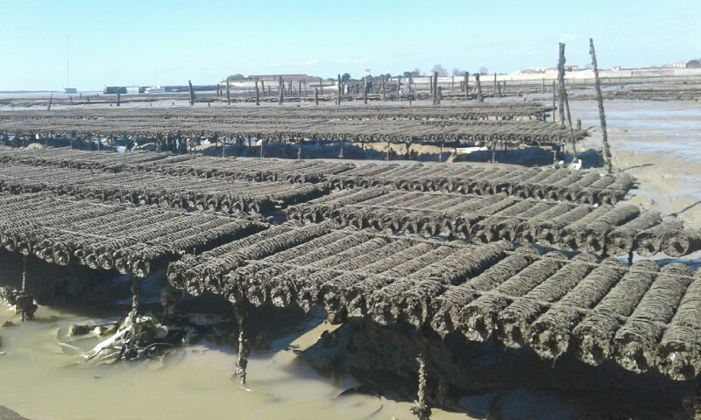
Crassostrea (Magallana) gigas Pacific cupped oyster
Among the most important aquacultural shellfish worldwide
C. gigas aquaculture
- $1.2 Billion per year
- 644,000 tons per year
Eric Pante

Slide 5
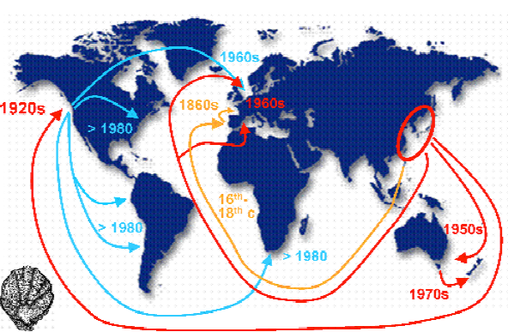
Crassostrea (Magallana) gigas Pacific cupped oyster
Among the most important aquacultural shellfish worldwide
Deliberately introduced to five continents for at least 150 years
Troost 2010

Slide 6
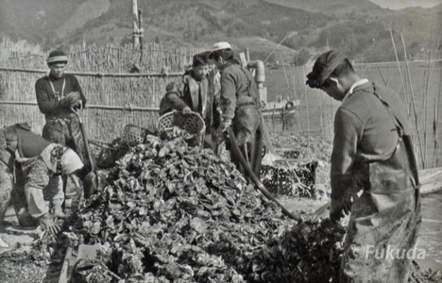
Crassostrea (Magallana) gigas Pacific cupped oyster
Among the most important aquacultural shellfish worldwide
Deliberately introduced to five continents for at least 150 years
An important 20th century vector for nonnative marine and estuarine species*
Professor Yasuyuki Koike
Oyster World Congress 2012
*Naylor et al., 2001, Ruiz et al. 2015, Ruesink et al. 2000

Slide 7
The greatest agency of all that spreads marine animals to new quarters of the world must be the business of oyster culture, a very ancient and world-wide craft. – Charles Elton (1958)

Slide 8
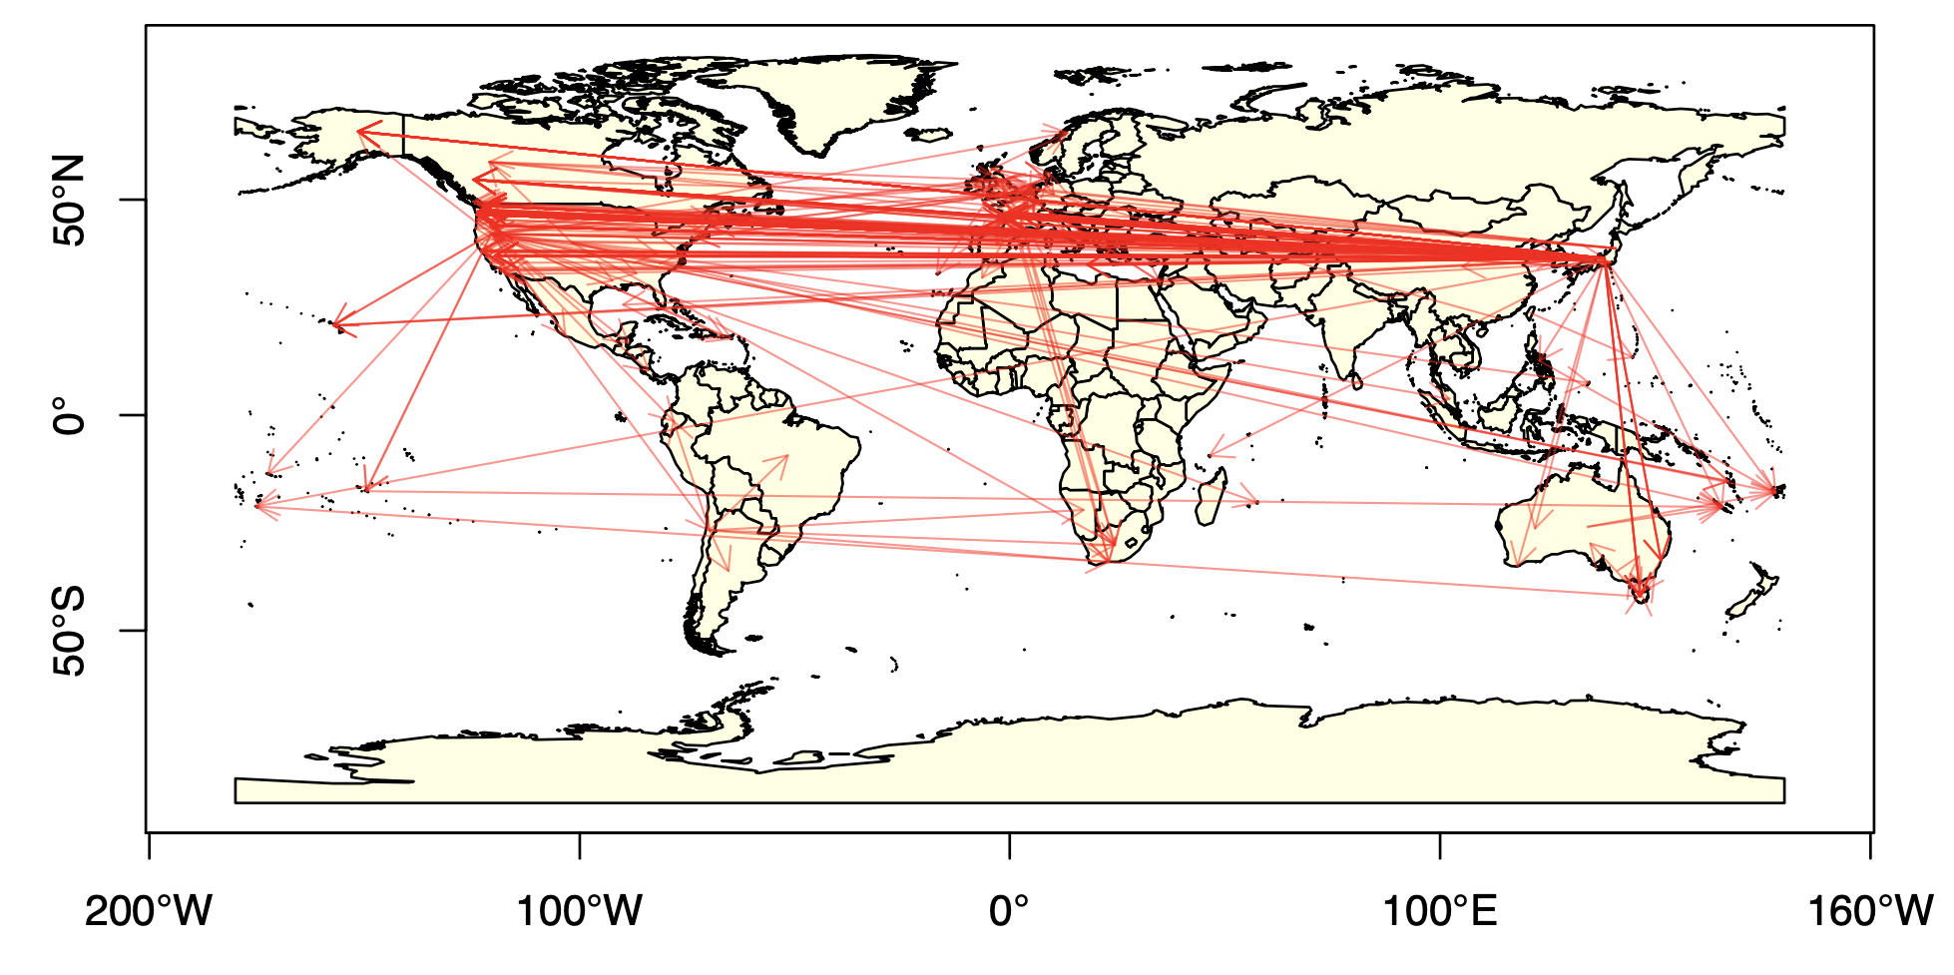
Historical record of introductions is extensive but not confirmed
405 records of Pacific Oyster shipments
- Compiled by Laney Pound (CofC)

Slide 9
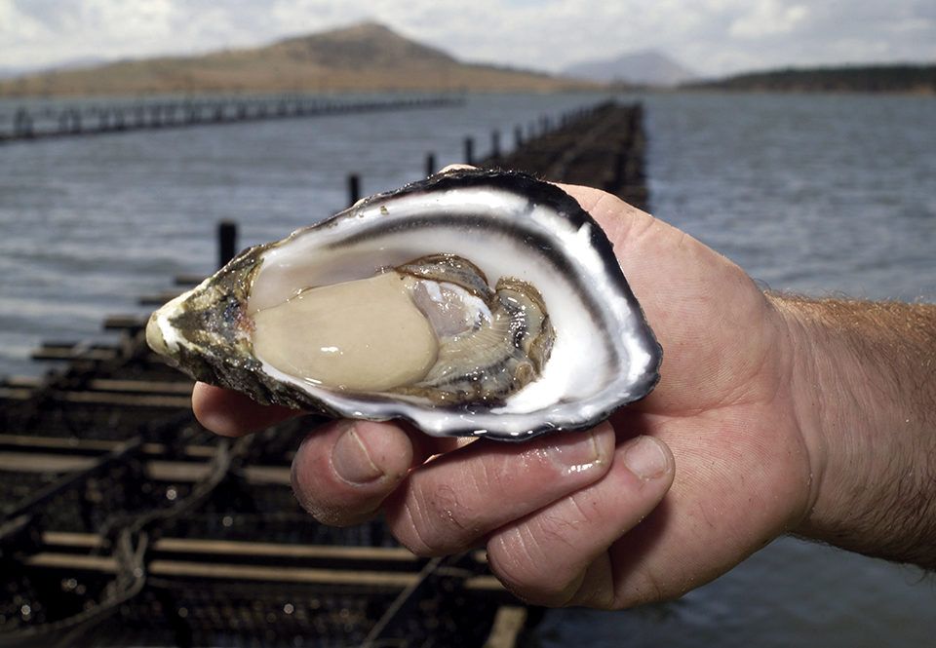
Genetic legacy of Pacific oyster introductions
Population genetic structure of native populations
The invasion history of non-native populations
Detecting signatures of oyster invasions on putatively co-introduced algae and invertebrates
Bruce Miller, CSIRO

Slide 10
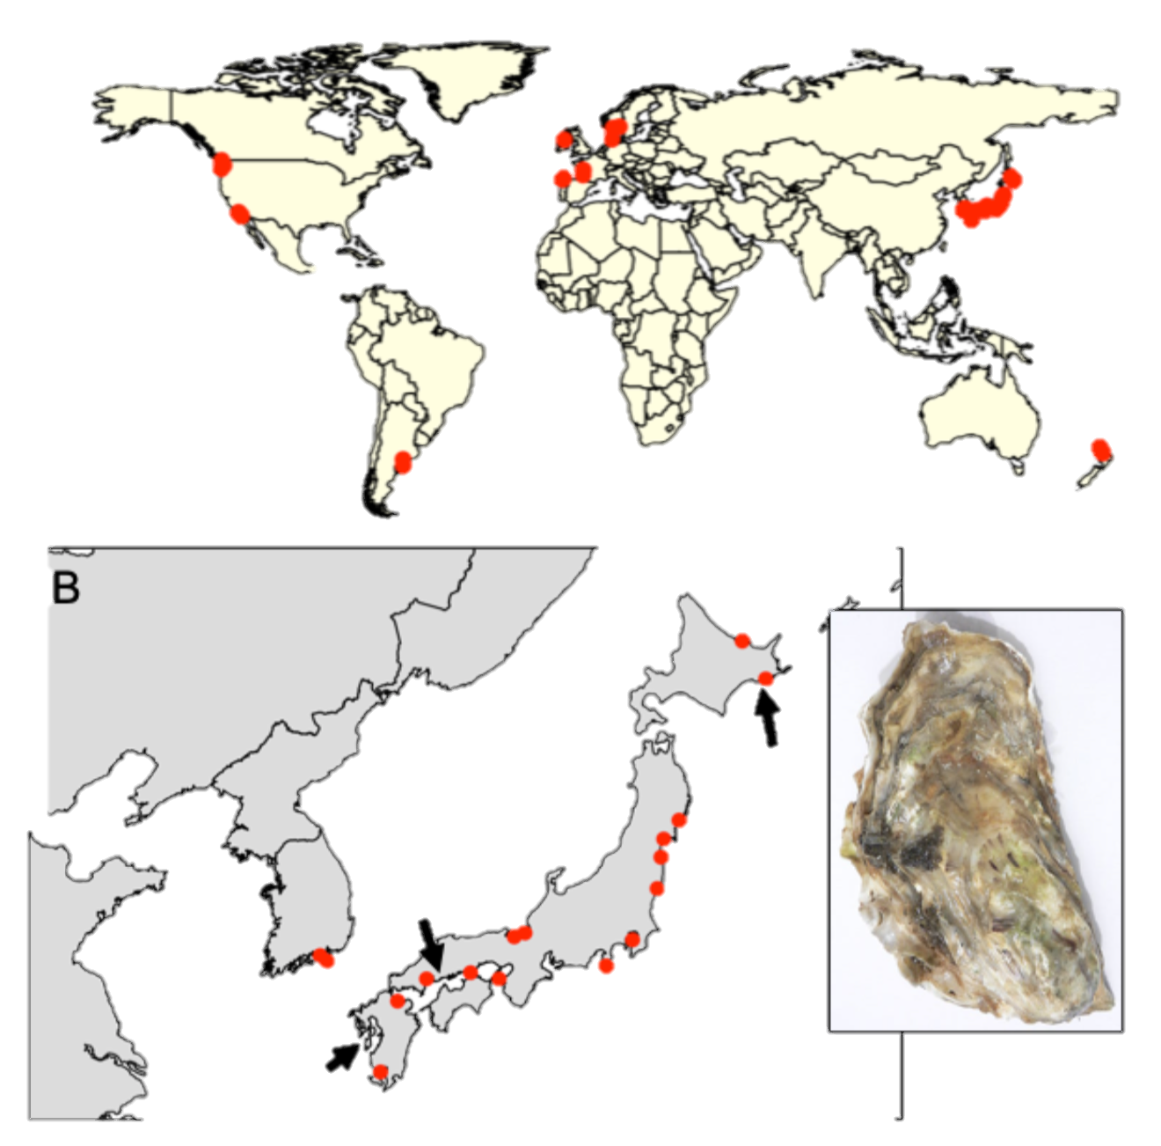
Sampling design
41 populations (n ~ 20)
20 native (Korea, Japan)
21 non-native (Europe, Western US, Chile, Argentina, NZ)
Feral populations (on rocks, jetties, reefs, etc..)
Genotype-by-sequencing
Dataset: 726 individuals from 7046 loci (no missing data and at HWE)
Hokkaido
Miyagi
Hiroshima
Kumamoto
Notes:
Kumamoto C. sikamea oyster

Slide 11
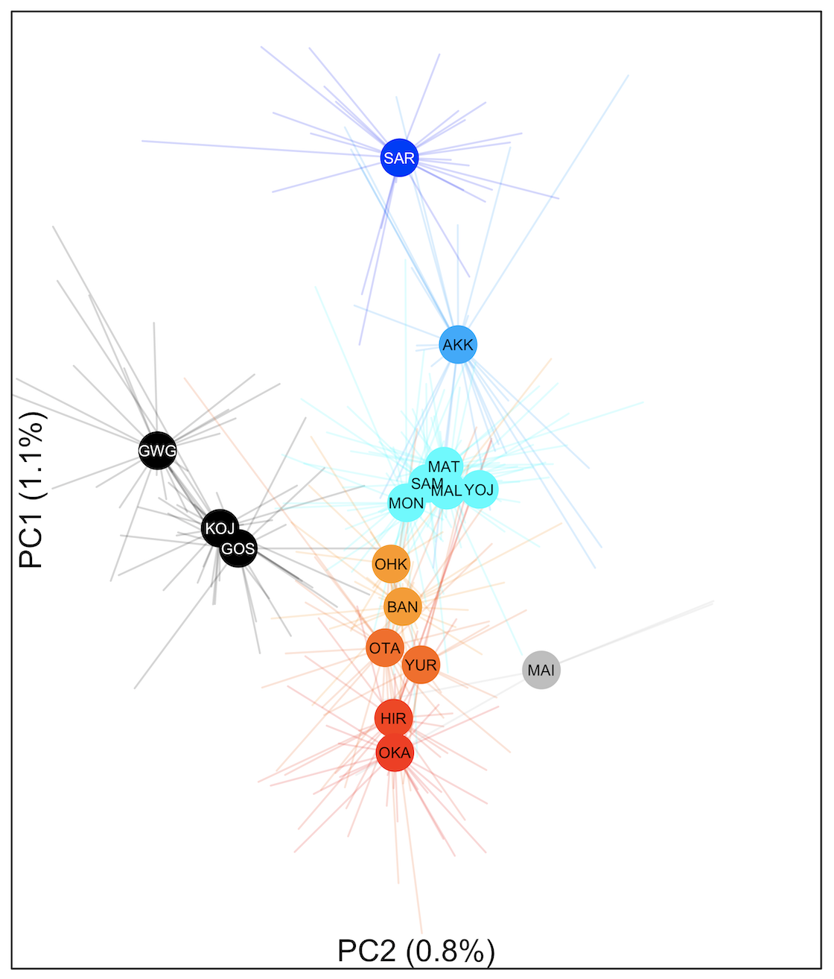
Genetic differentiation along latitude in Japan Φ_{ST} = 0 to 0.011
colors based on Genetic PC1
Hokkaido
Miyagi
Hiroshima
**

Slide 12
Genetic differentiation correlates with sea surface temperature
Hokkaido
Miyagi
Hiroshima

Slide 13
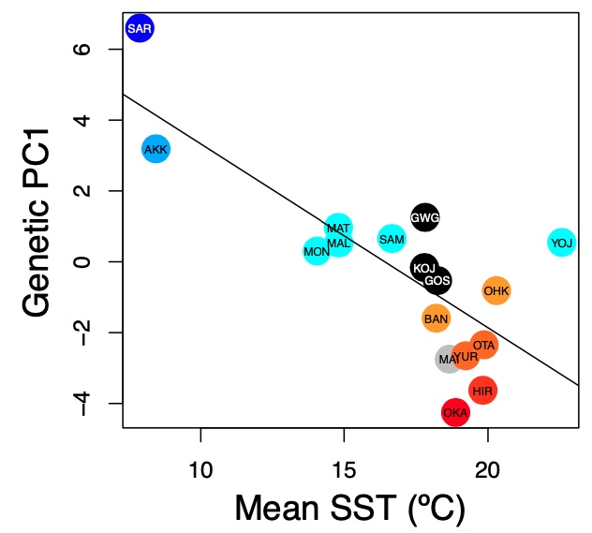
Genetic differentiation correlates with sea surface temperature
Native: r = -0.777; p< 0.001

Slide 14
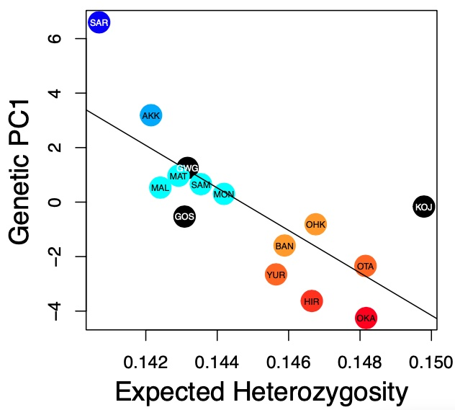
Genetic differentiation correlates with heterozygosity
Native: r = -0.755; p = 0.001
Native: r = -0.777; p< 0.001

Slide 15
Genetic legacy of Pacific oyster introductions
Population genetic structure of native populations
The invasion history of non-native populations
Detecting signatures of oyster invasions on putatively co-introduced algae and invertebrates
Bruce Miller, CSIRO

Slide 16
Non-native populations assigned to native sources
colors based on Genetic PC1

Slide 17
New Zealand were from southern Japan (Hiroshima / Seto Inland Sea)
From Seto Inland Sea
colors based on Genetic PC1

Slide 18
Southern California were most likely from Tokyo
From Tokyo
From Seto Inland Sea
colors based on Genetic PC1

Slide 19
Other populations stem from Miyagi (northwestern Honshu)
From Tokyo
From Seto Inland Sea
colors based on Genetic PC1

Slide 20
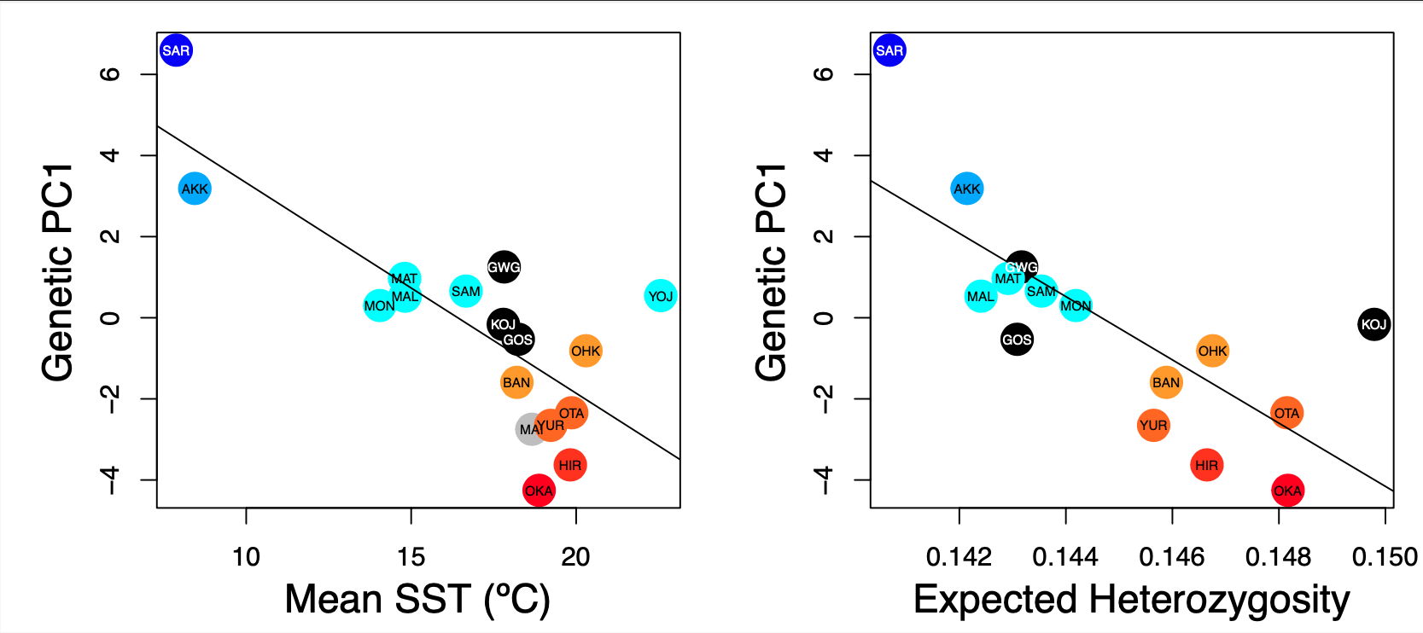
Native: r = -0.777; p< 0.001
Native: r = -0.755; p = 0.001

Slide 21
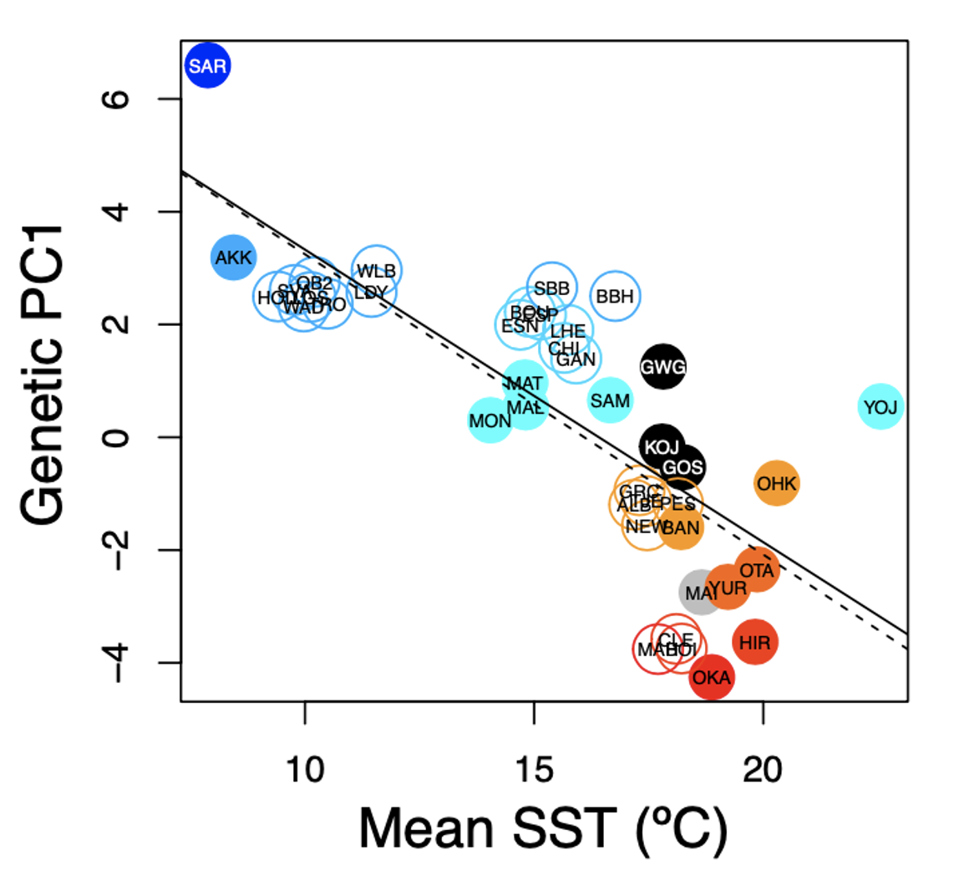
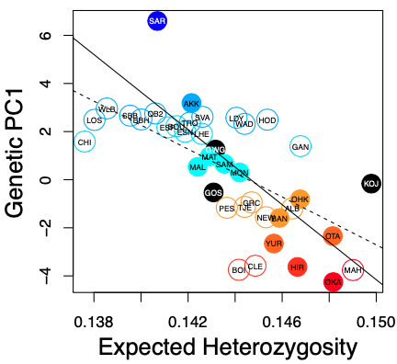
“Deliberate” ecological fitting
Native: r = -0.777; p< 0.001
Introduced r = -0.744; p< 0.001

Slide 22
Genetic legacy of Pacific oyster introductions
Population genetic structure of native Pacific oysters (China, Korea, Japan)
The invasion history of non-native populations (USA, Europe, NZ, South America)
Signatures of Pacific oysters on putatively co-introduced species (algae and invertebrates)

Slide 23
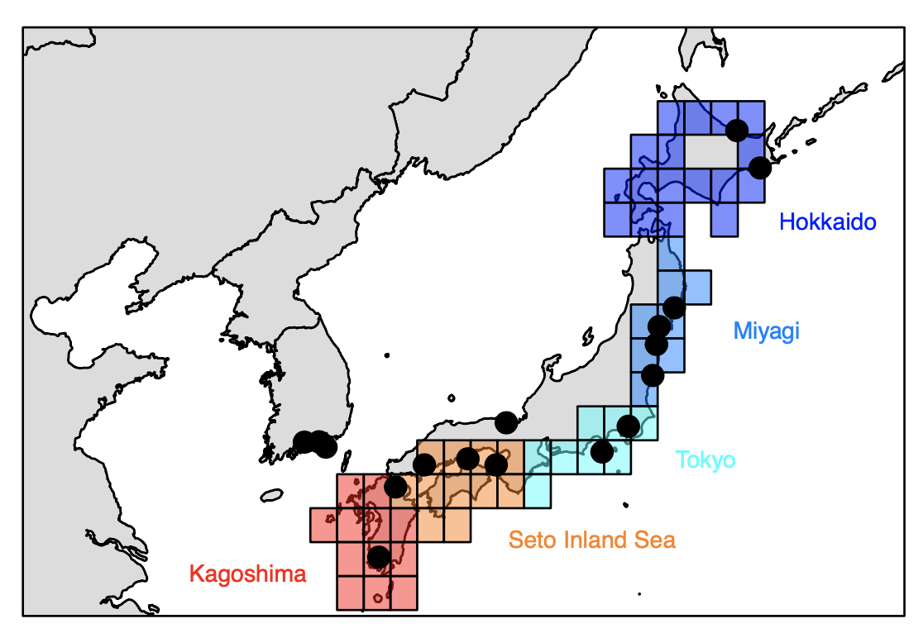
HOW DO WE RECONCILE THE SOUTHERN CALIFORNIA RESULT??????

Slide 24
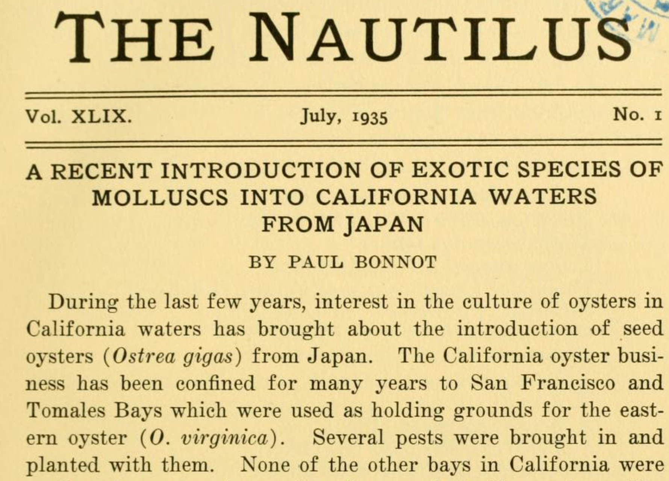

Slide 25
The greatest agency of all that spreads marine animals to new quarters of the world must be the business of oyster culture, a very ancient and world-wide craft. – Charles Elton (1958)

Slide 26
Bonnot (1935) documented the occurrence of invasive mollusks with imported Japanese oyster shipments to North American estuaries.
From ad hoc reviewers of K-H 2017 at Mol Ecol
Furthermore, their claims to identify the vector (C. gigas) remains purely speculative - this would be confirmed by congruent patterns of genetic diversity of both C. gigas and G. vermiculophylla in their native and introduced ranges.
"... our results support anecdotal evidence that oysters were the key vector for the G. vermiculophylla invasion." Congruent patterns of genetic diversity across the two species would have clarified this - as it is, there is only "arm-waving".
All in all, there is not conclusive evidence in the manuscript to convince the reader about the role of C. gigas as a vector beside the coincidental presence in the northern hemisphere. A comparison between the genetic structure of the vector and of the alga could have been attempted.
“Because this area historically served as the principal source for oyster exports worldwide, we suggest that oysters were the key vector for the G. vermiculophylla invasion. “ Krueger-Hadfield et al 2017 Ecology and Evolution
“The source region historically provided seed oysters (Crassostrea gigas) for aquaculture in North America” Miura et al. 2001 PNAS

Slide 27
Pacific oysters from Europe and Canada, Washington state came from northern Japan
Circlize plots; Machine learning

Slide 28
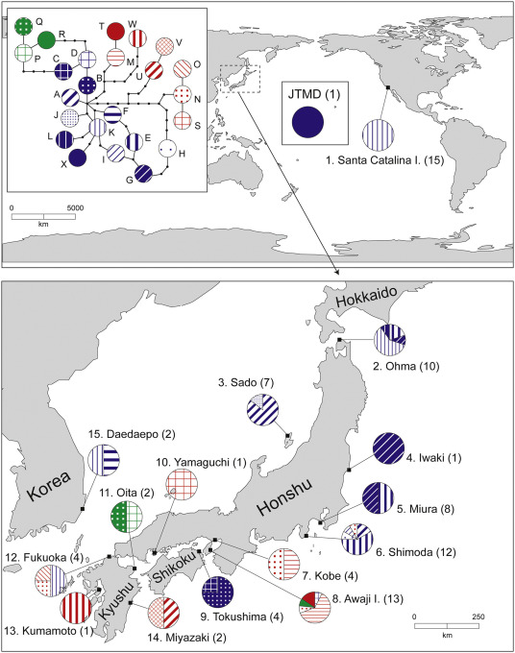

Slide 29
Pacific oysters from southern California are a mix of northern and southern Japan
Pacific oysters from New Zealand came from southern Japan
Circlize plots; Machine learning

Slide 30
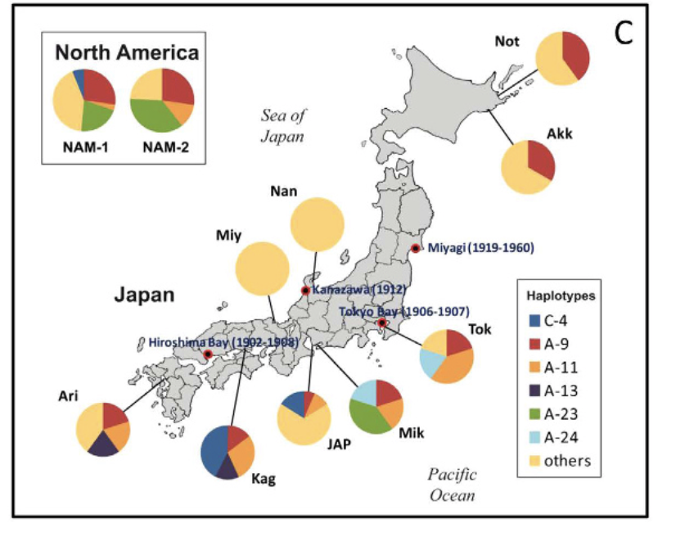
Notes:
Ruditapes

Slide 31
Battillaria attramentaria
Miura et al. 2005 PNAS

Slide 32
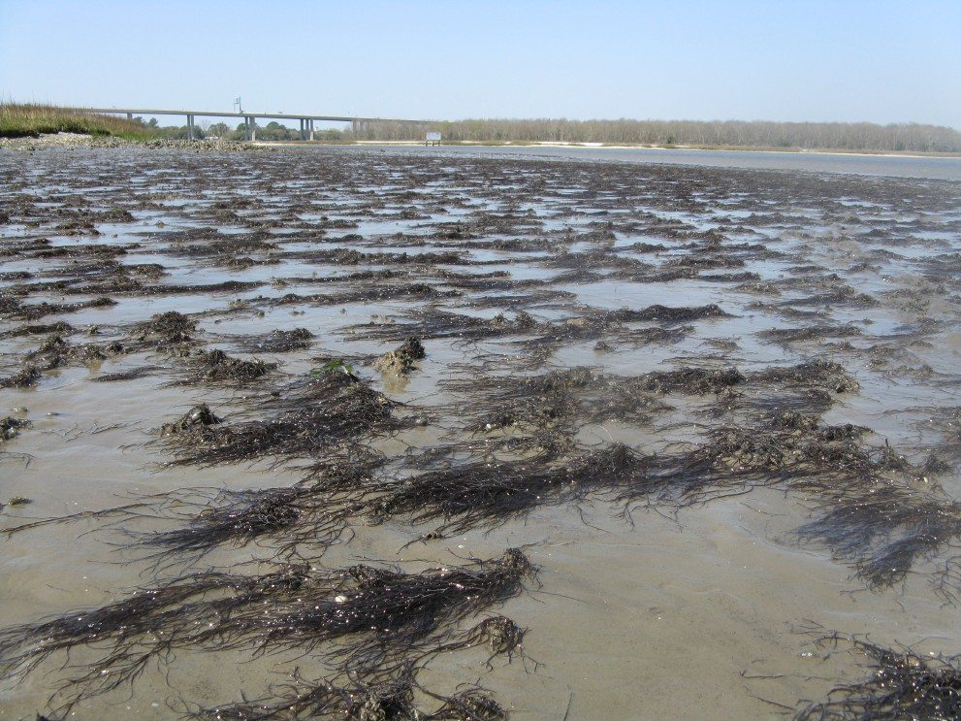
Gracilaria vermiculophylla

Slide 33
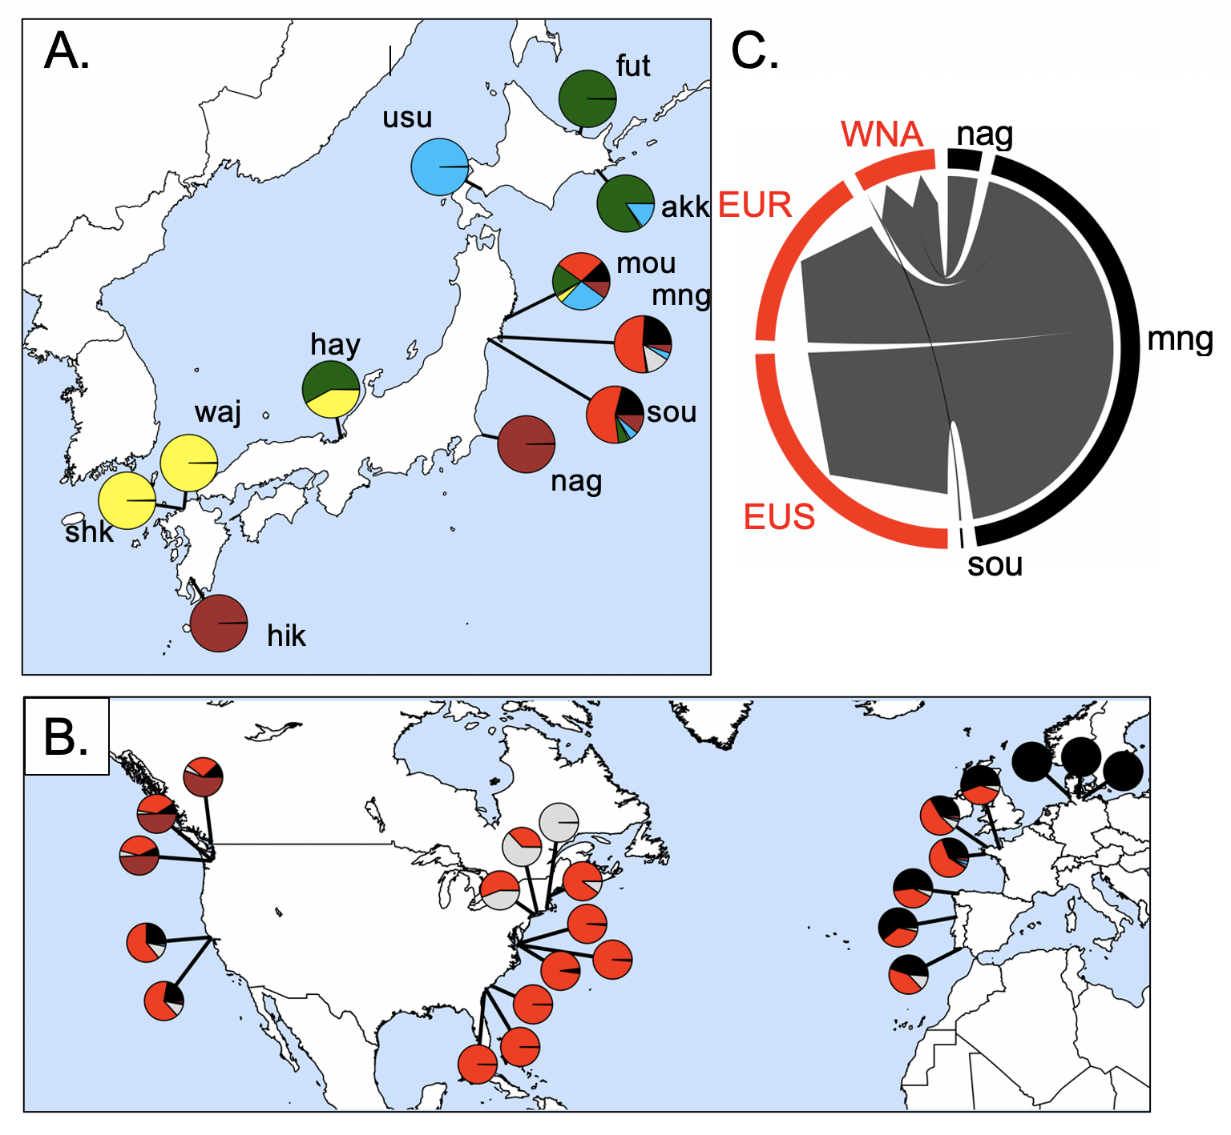
Source of the invasion is northeastern Japan
62,235 SNPs
32 populations
Admixture analysis
Flanagan, Krueger-Hadfield, Murren, Nice, Strand and Sotka (in press) Molecular Ecology

Slide 34
Results (so far)
We can trace genetic history of feral Crassostrea gigas back to native sources
Northern Japan was source for NW North America, southern Europe
Southern Japan source for California and New Zealand
Strange “hybrid” / inbred line / Sea of Japan lineage is found in South America and northern Europe
The environment of native sources predicts local non-native environments.
This suggests either ecological fitting or strain dispersal (or others?)

Slide 35
We note that our approach is to collect feral populations today to infer neutral dispersal patterns that occurred in the past; thus, our interpretations of geographic patterns must keep this limitation in mind. For example, concluding that Pacific Northwest individuals came from northern Japan and southern California from southern Japan may indicate a) the historical record is incorrect or b) the historical record is correct, oysters arrived from all over Japan, but a subset of genotypes created feral populations that survive today.

Slide 36
Argentina | Evangelina Schwindt
Chile | Martin Thiel, Jim Carlton
Denmark | Asa Strand
France | Eric Pante
Ireland | Asa Strand, Judith Kochmann
Japan | Takefumi Yorisue, Masahiro Nakaoka, Mits Kanaya, Masahiro Hori, Gen Kanaya, Ryuta Terada, Hikaru Endo
Korea | Kun-Seop Lee
New Zealand | Richard Taylor
Norway | Asa Strand
USA | Jennifer Ruesink, Hilary Heyford, Danielle Zacherl, Jeff Crooks
Spain | Lucia Couceiro
Sweden | Asa Strand, Judith Kochmann

Slide 38
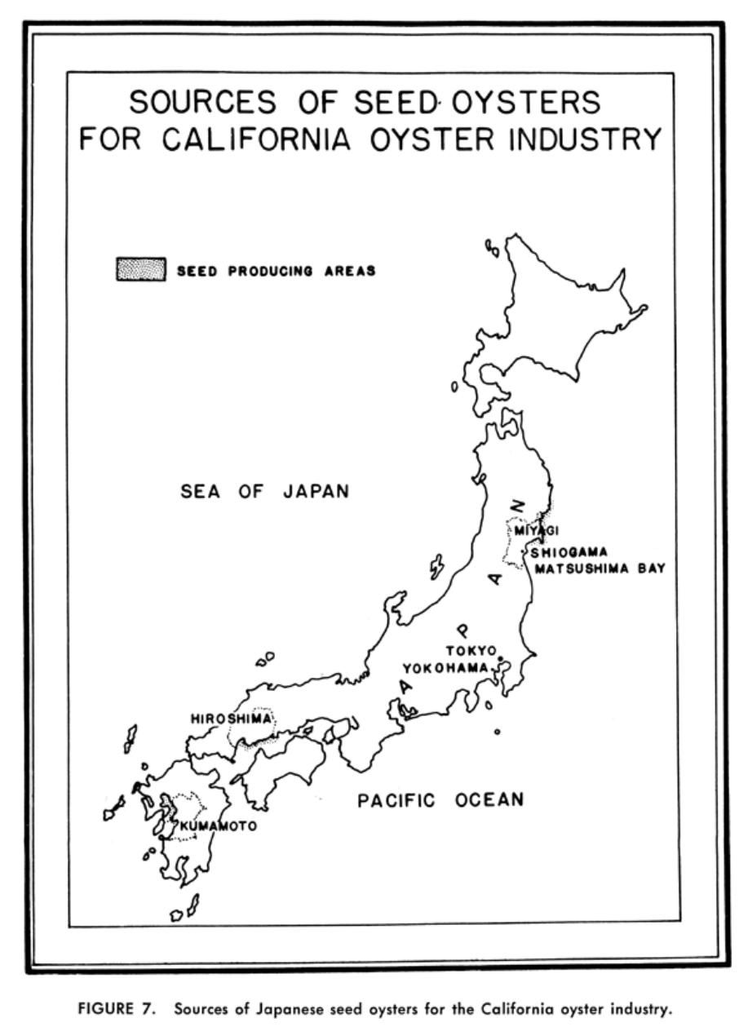
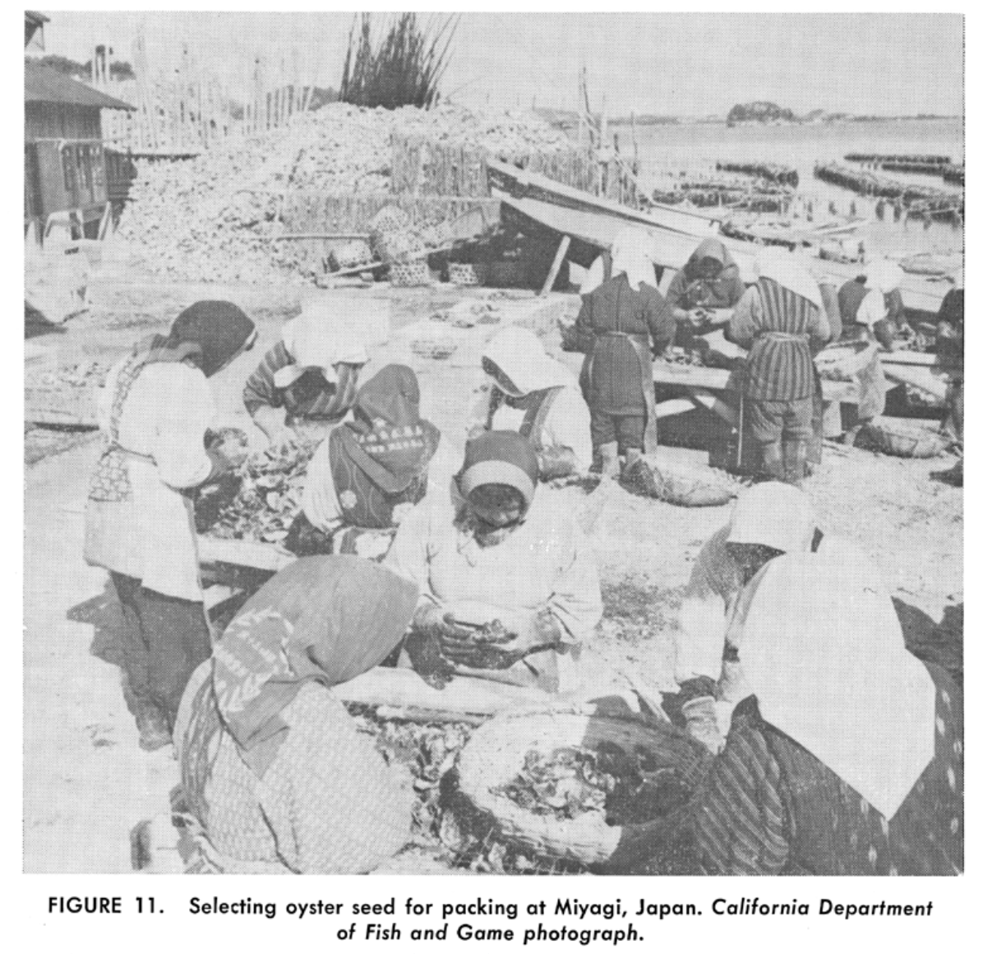
Barrett 1963

Slide 39
Colors for the PC

Slide 40
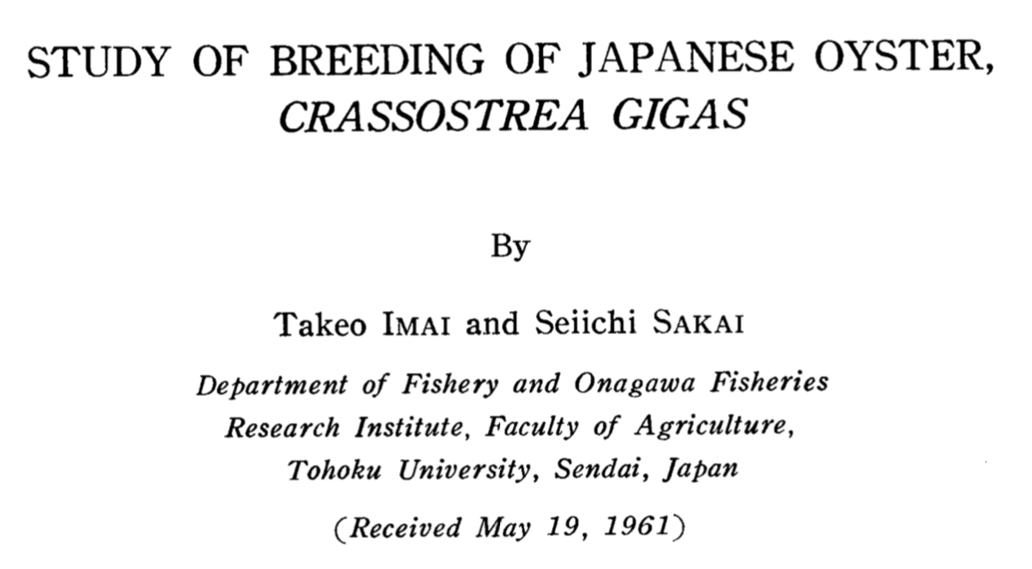
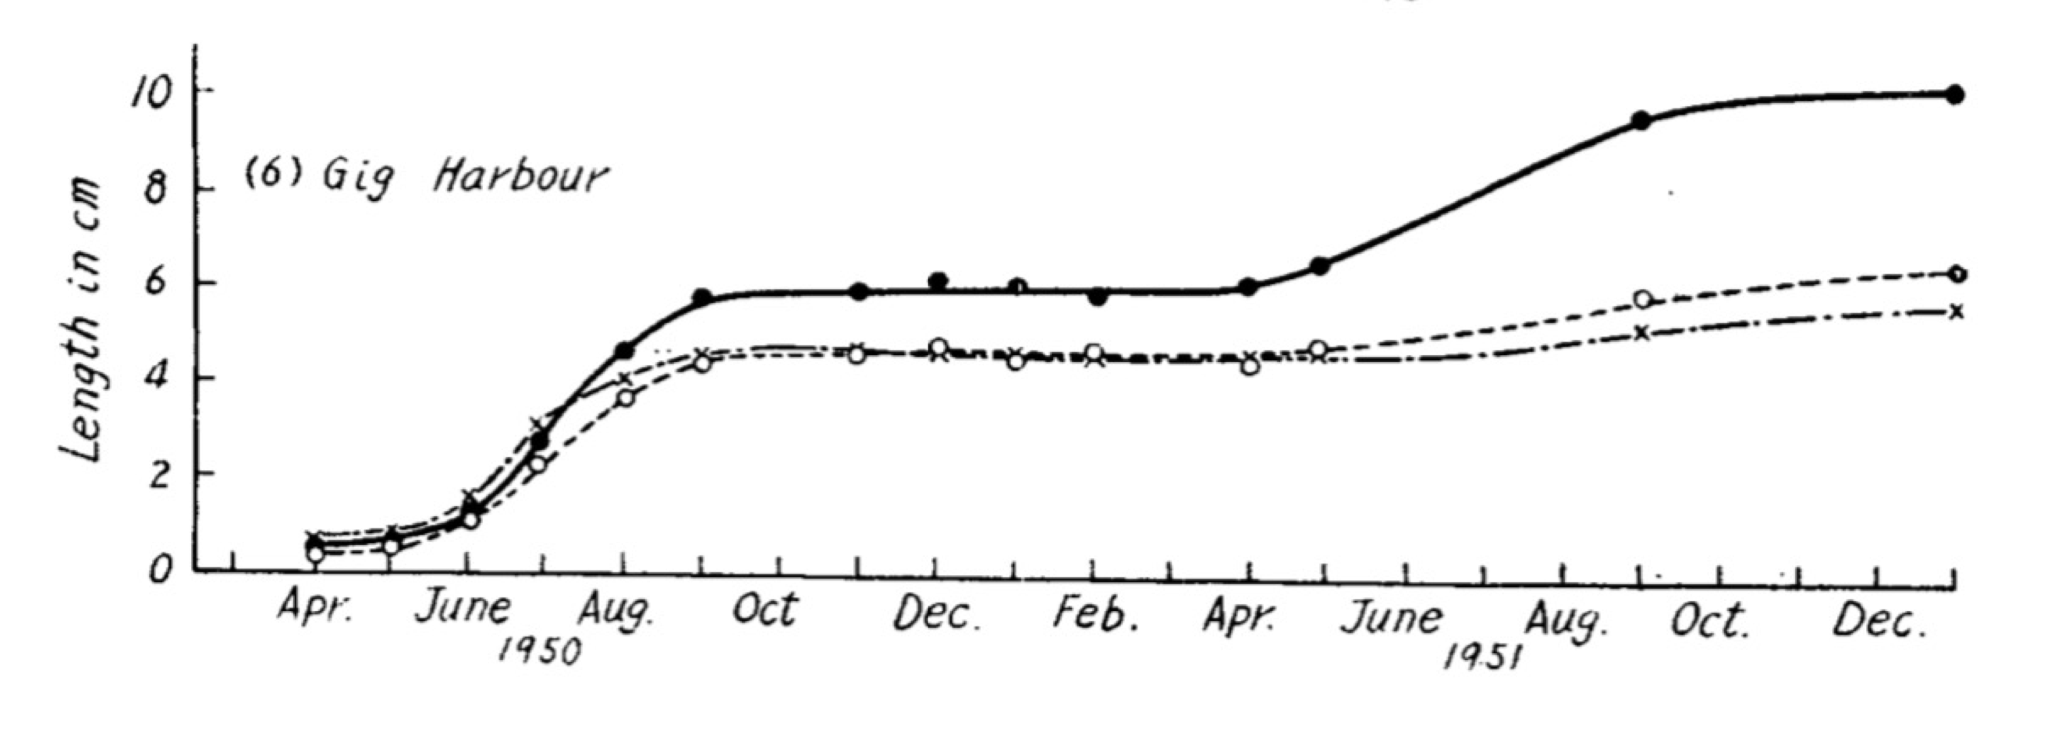
Northern Japan oysters (38% mortality)
Southern Japan oysters (74% mortality)
Northern (44ºN) Japanese oysters had greater fitness in Puget Sound WA (47ºN) relative to Southern (33ºN) Japanese oysters
Northern Japan
Southern Japan

Slide 41
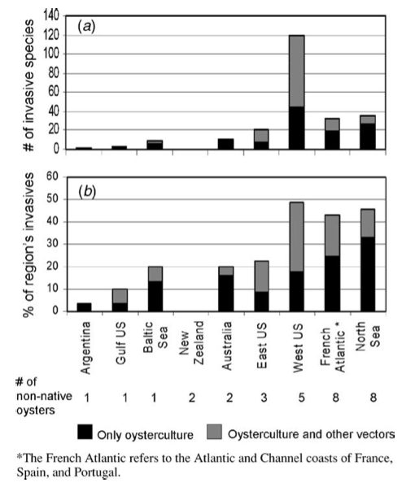
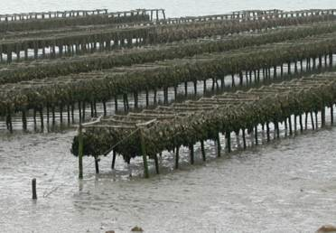
Dozens of species that moved with C. gigas
Ruesink et al. 2005 ARES

Slide 42
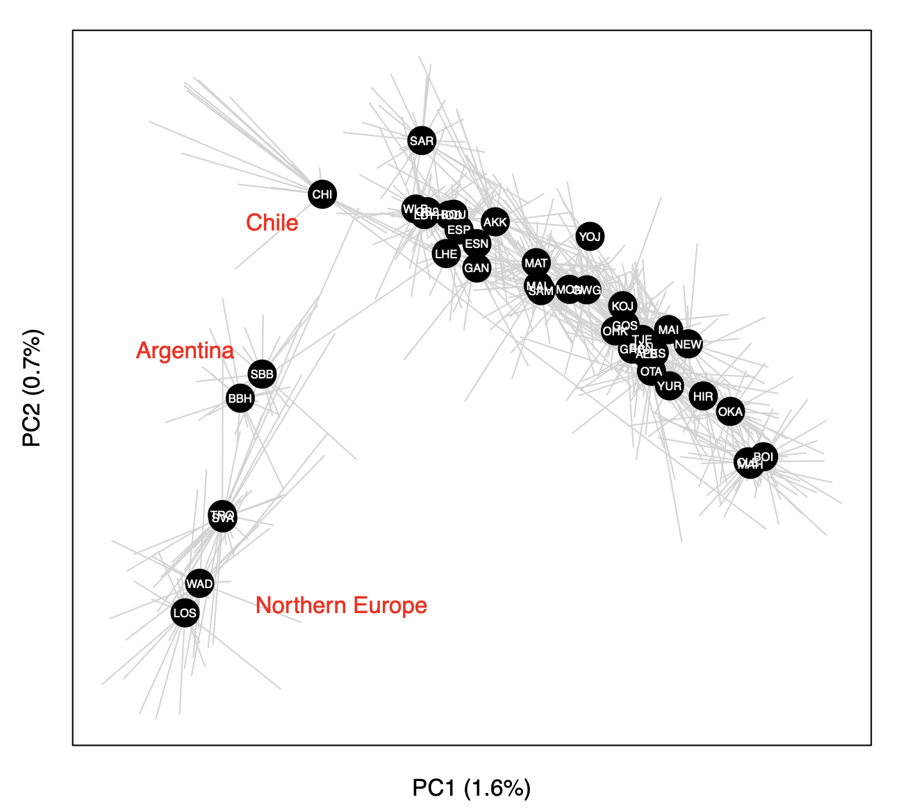
Principal components analysis (PCA) of 726 oysters using 7046 loci

Slide 43
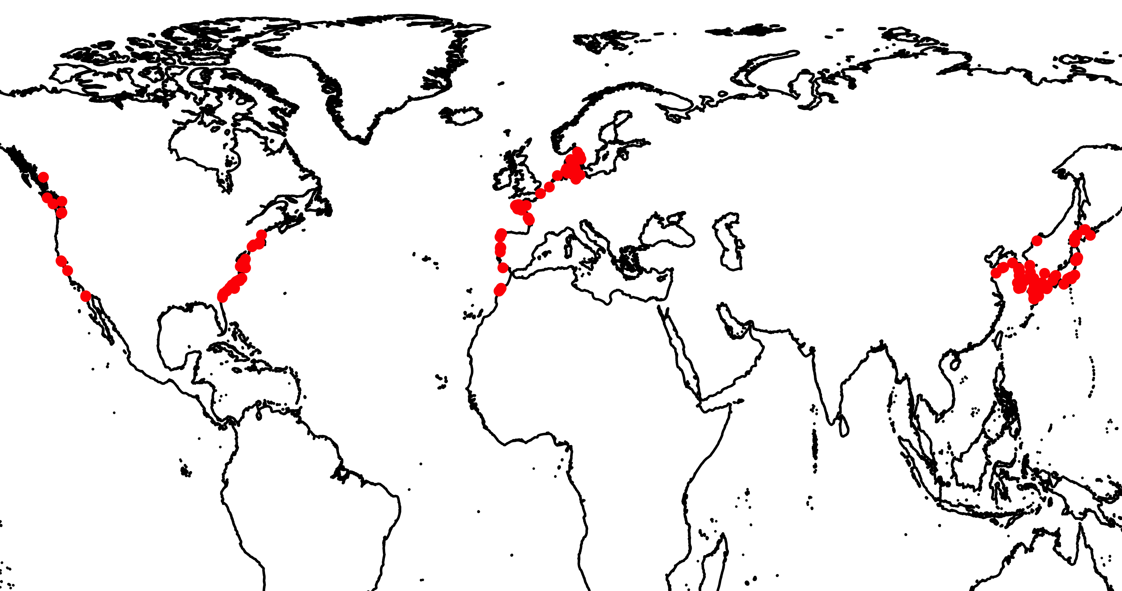
G. vermiculophylla distribution
Introduced: Europe
Introduced: North America
Native

Slide 44
Source of the invasion is northeastern Japan
Annual Sea Surface
Temperature (ºC)
Flanagan, Krueger-Hadfield, Murren, Nice, Strand and Sotka (in press) Molecular Ecology

Slide 45
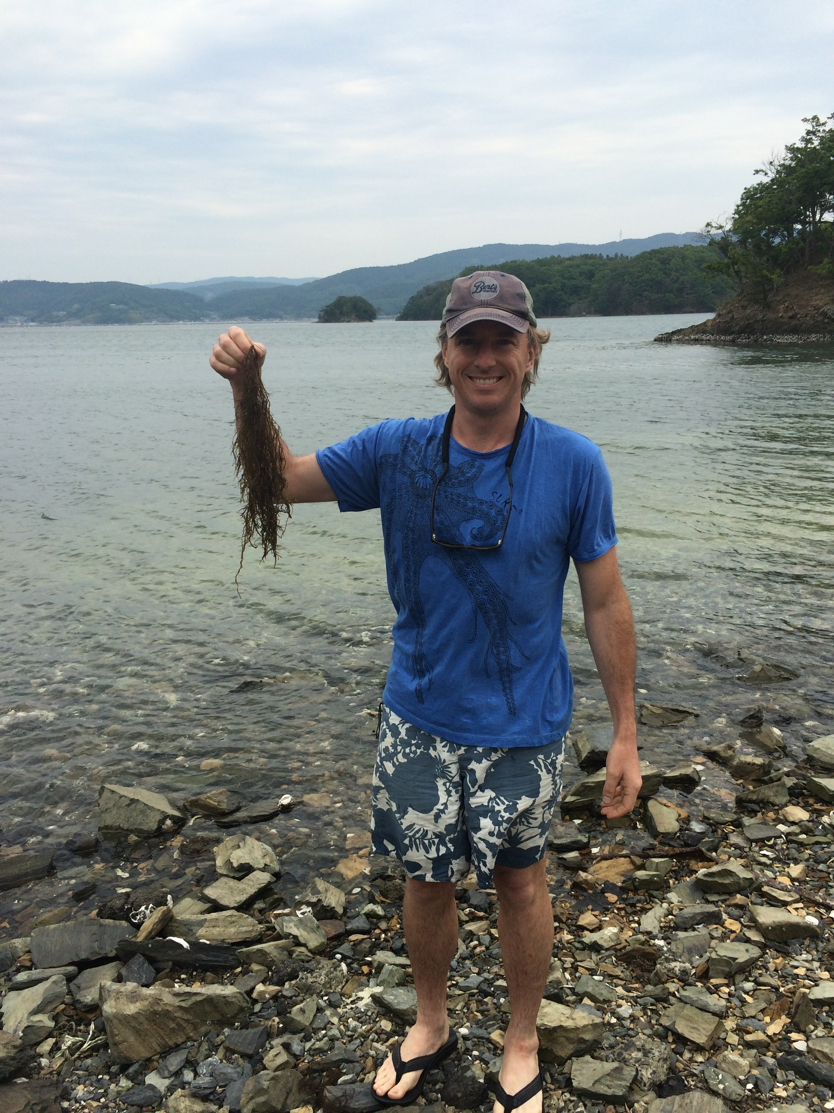
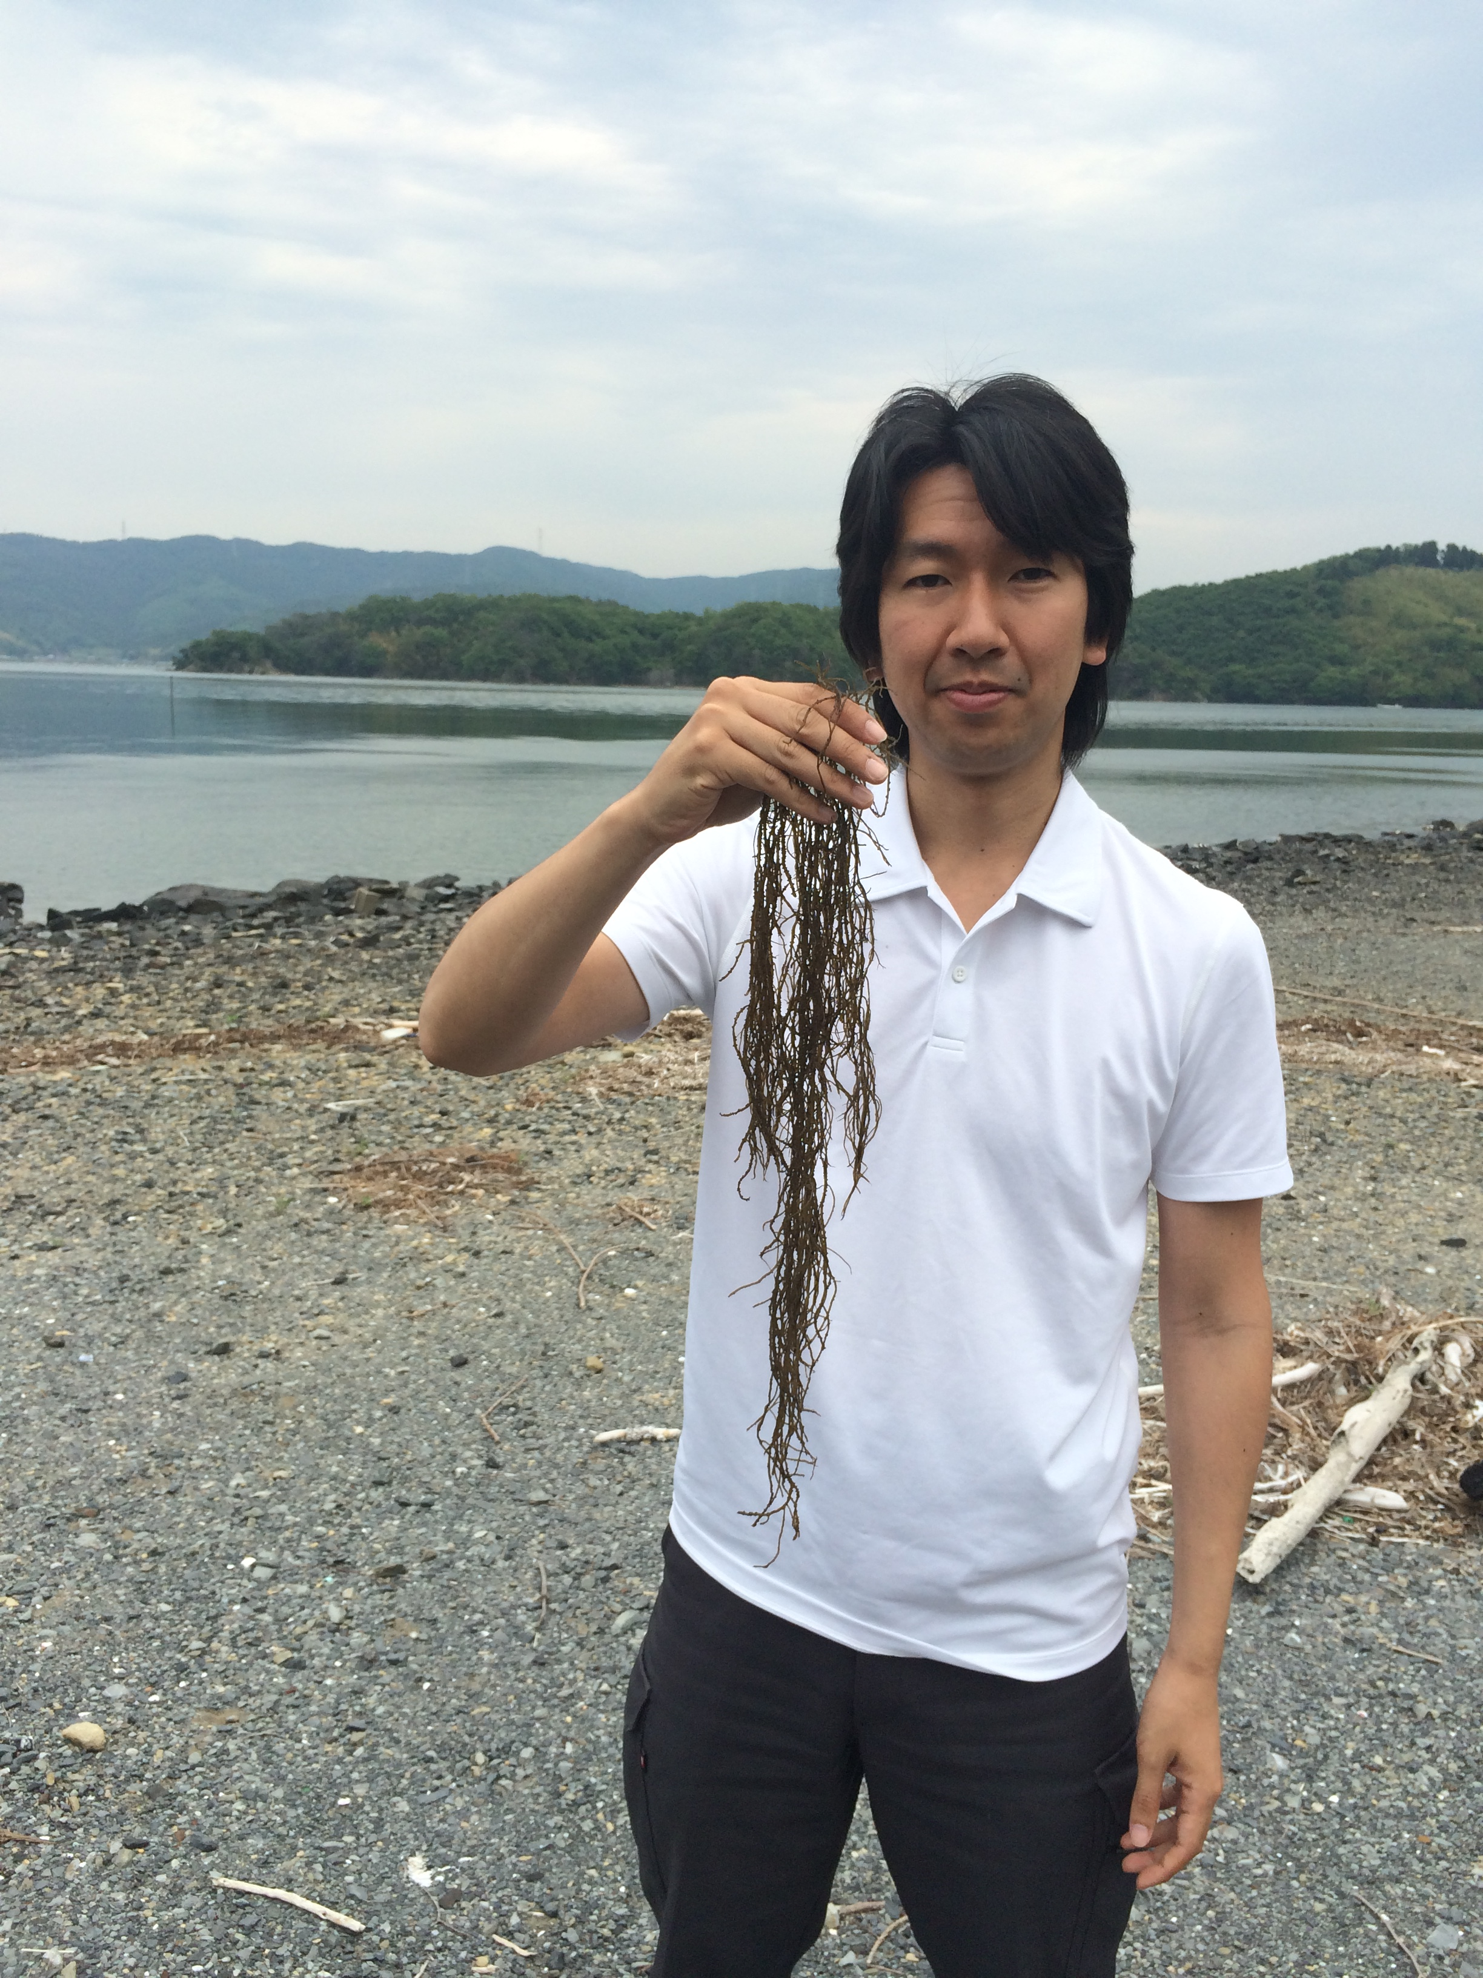
Mangoku-ura, Japan
May 2015

